Slide 1

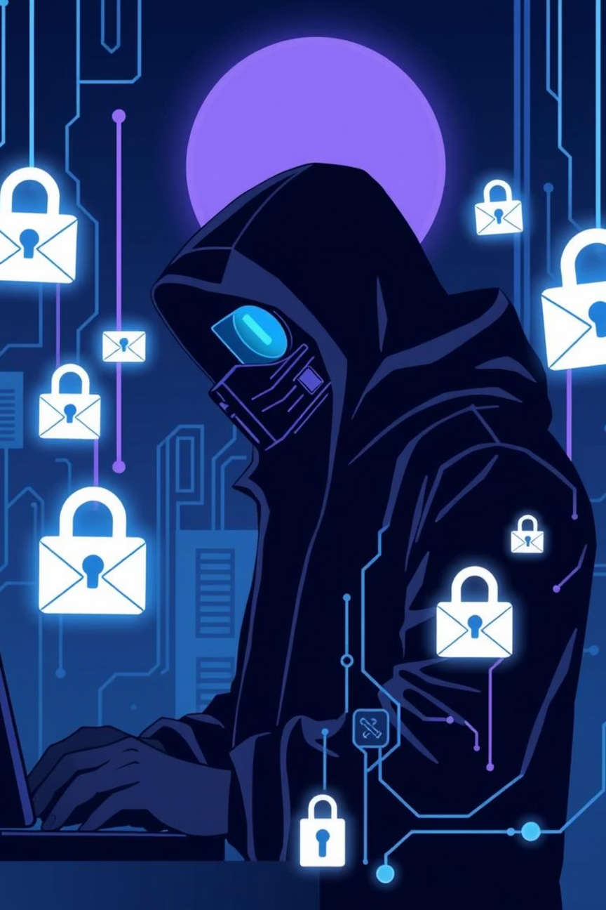

Phishing Awareness Training
Recognize. Report. Protect.
Stay alert. Stay safe.
AHAD PARVAIZ

Slide 2






Understanding Phishing: Your Shield Against Cyber Threats
This training empowers you to identify and defend against phishing attacks, safeguarding your personal and organizational data. You'll learn the common tactics used by cybercriminals and discover best practices for online safety.
Phishing is a cybercrime where attackers trick individuals into revealing sensitive information or deploying malicious software. It can take many forms:
What You'll Learn
Email Phishing
Recognize various phishing types
Identify social engineering tactics
Deceptive emails posing as legitimate entities.
Apply best practices for prevention
Smishing (SMS)
Phishing attempts via text messages.
Why It Matters
Vishing (Voice)
Protect personal information
Fraudulent calls designed to extract information.
Secure company data
Maintain trust and integrity
Fake Websites
Cloned sites designed to steal login credentials.
AHAD PARVAIZ

Slide 3
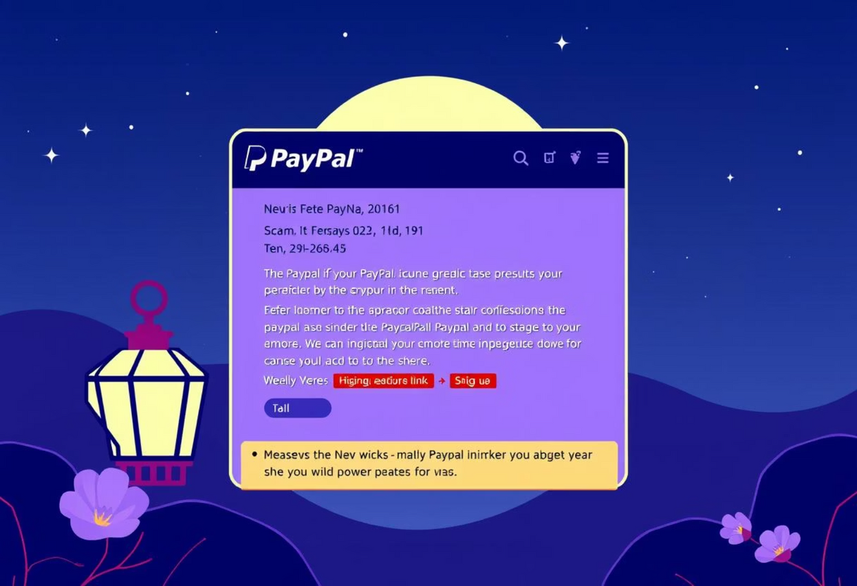
Spotting the Red Flags: Real-World Examples
Example 1: Fake PayPal Email 📧
Suspicious Sender: Look for mismatched sender addresses.
Malicious Link: Hover over links to check the true destination.
Spelling/Grammar: Professional companies rarely make such errors.
Urgent Tone: Demands immediate action or threatens consequences.
Your Action Plan: Recognize, Report, Protect!
Always Verify
Before clicking links or sharing info, verify the sender via official channels (phone call, separate browser search).
Think Before You Click
If something feels off, it probably is. Don't click unknown links or download attachments.
AHAD PARVAIZ
Use MFA
Report Suspicious Activity
Enable Multi-Factor Authentication for all accounts to add an extra layer of security.
Forward suspicious emails to your security team or IT department immediately. Don't delete them!

Slide 4
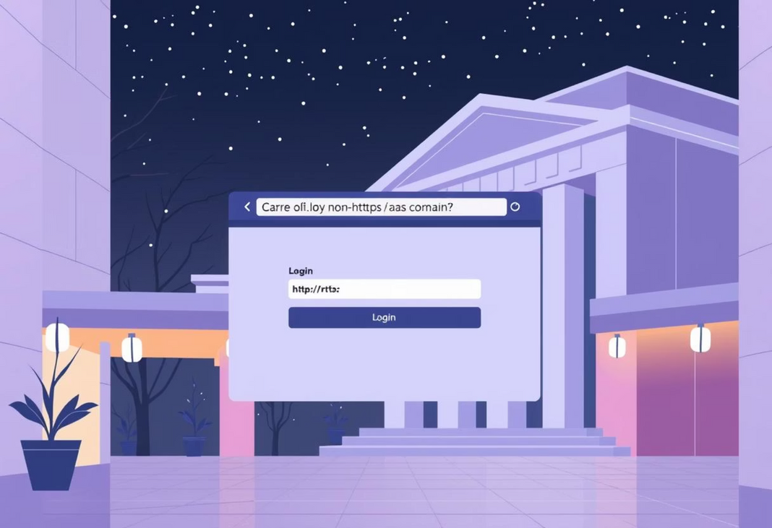
Spotting the Red Flags: Real-World Examples
Example 2: Fake Bank Login Page 🔒
Non-HTTPS URL: Secure sites always start with https://.
Suspicious Domain: Check for slight misspellings or unusual extensions.
Asks for Full PIN/Password: Legitimate sites rarely ask for full credentials.
Poor Design/Branding: Inconsistent logos or low-quality graphics.
Your Action Plan: Recognize, Report, Protect!
Always Verify
Before clicking links or sharing info, verify the sender via official channels (phone call, separate browser search).
Think Before You Click
If something feels off, it probably is. Don't click unknown links or download attachments.
AHAD PARVAIZ
Use MFA
Report Suspicious Activity
Enable Multi-Factor Authentication for all accounts to add an extra layer of security.
Forward suspicious emails to your security team or IT department immediately. Don't delete them!

